Slide 1
The Poke shop
We believe in a healthy happy lifestyle

Slide 2
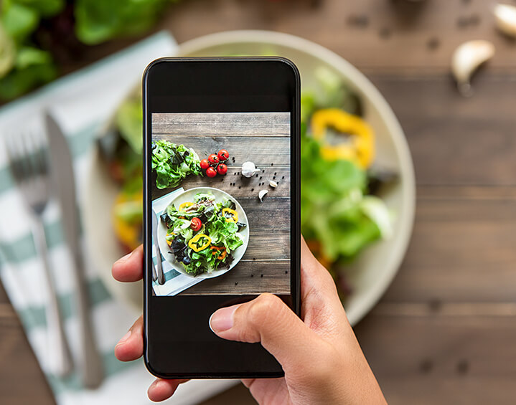

Overall Goal
The primary message of Poke is to offer our clients a delicious and healthy alternative to traditional fast-food
Healthy food doesn't have to be complicated; we want our clients to have an easy choice when finishing a long day of work.

Slide 3
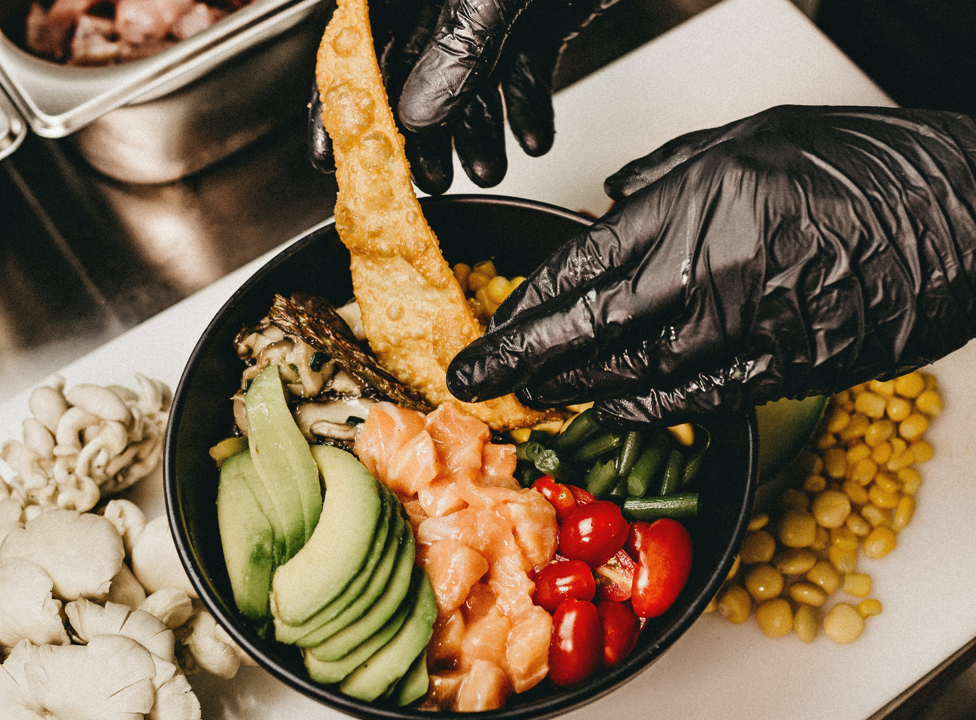
Custom Food
All of our restaurants are fully equipped with a custom menu, meaning our customers build what they really want to eat

Slide 4
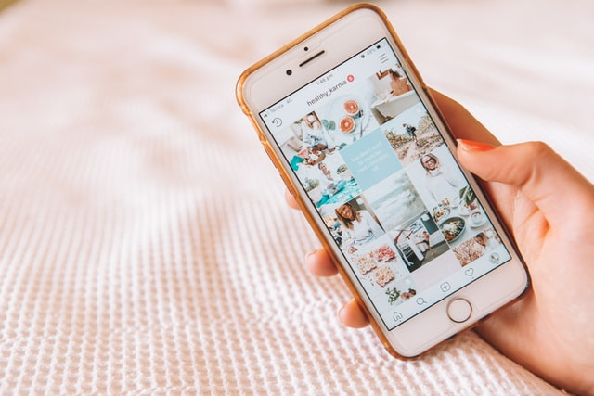
What is the purpose of the site? Why do you think this organization wants to share this information?
The purpose of this website is to provide information about our poke restaurant such as the location, contact information, the menu and special offers.
We want our restaurant to be easily reachable for customers. This organization wants to share this information because we want to inform and attract new customers.

Slide 5

Target audience and intended market
Audience
healthy meal-type also appeals to those looking for a nutritious alternative to usual fast food cuisine
The organization's message is directed at anyone that is hungry and looking for good and healthy food.

Slide 6

Objectives of our site
Social media
Bright colors
Order process

Slide 7
What we wish to accomplish
Synergy from the outside
Engaging with others
Deals with our influencers

Slide 8
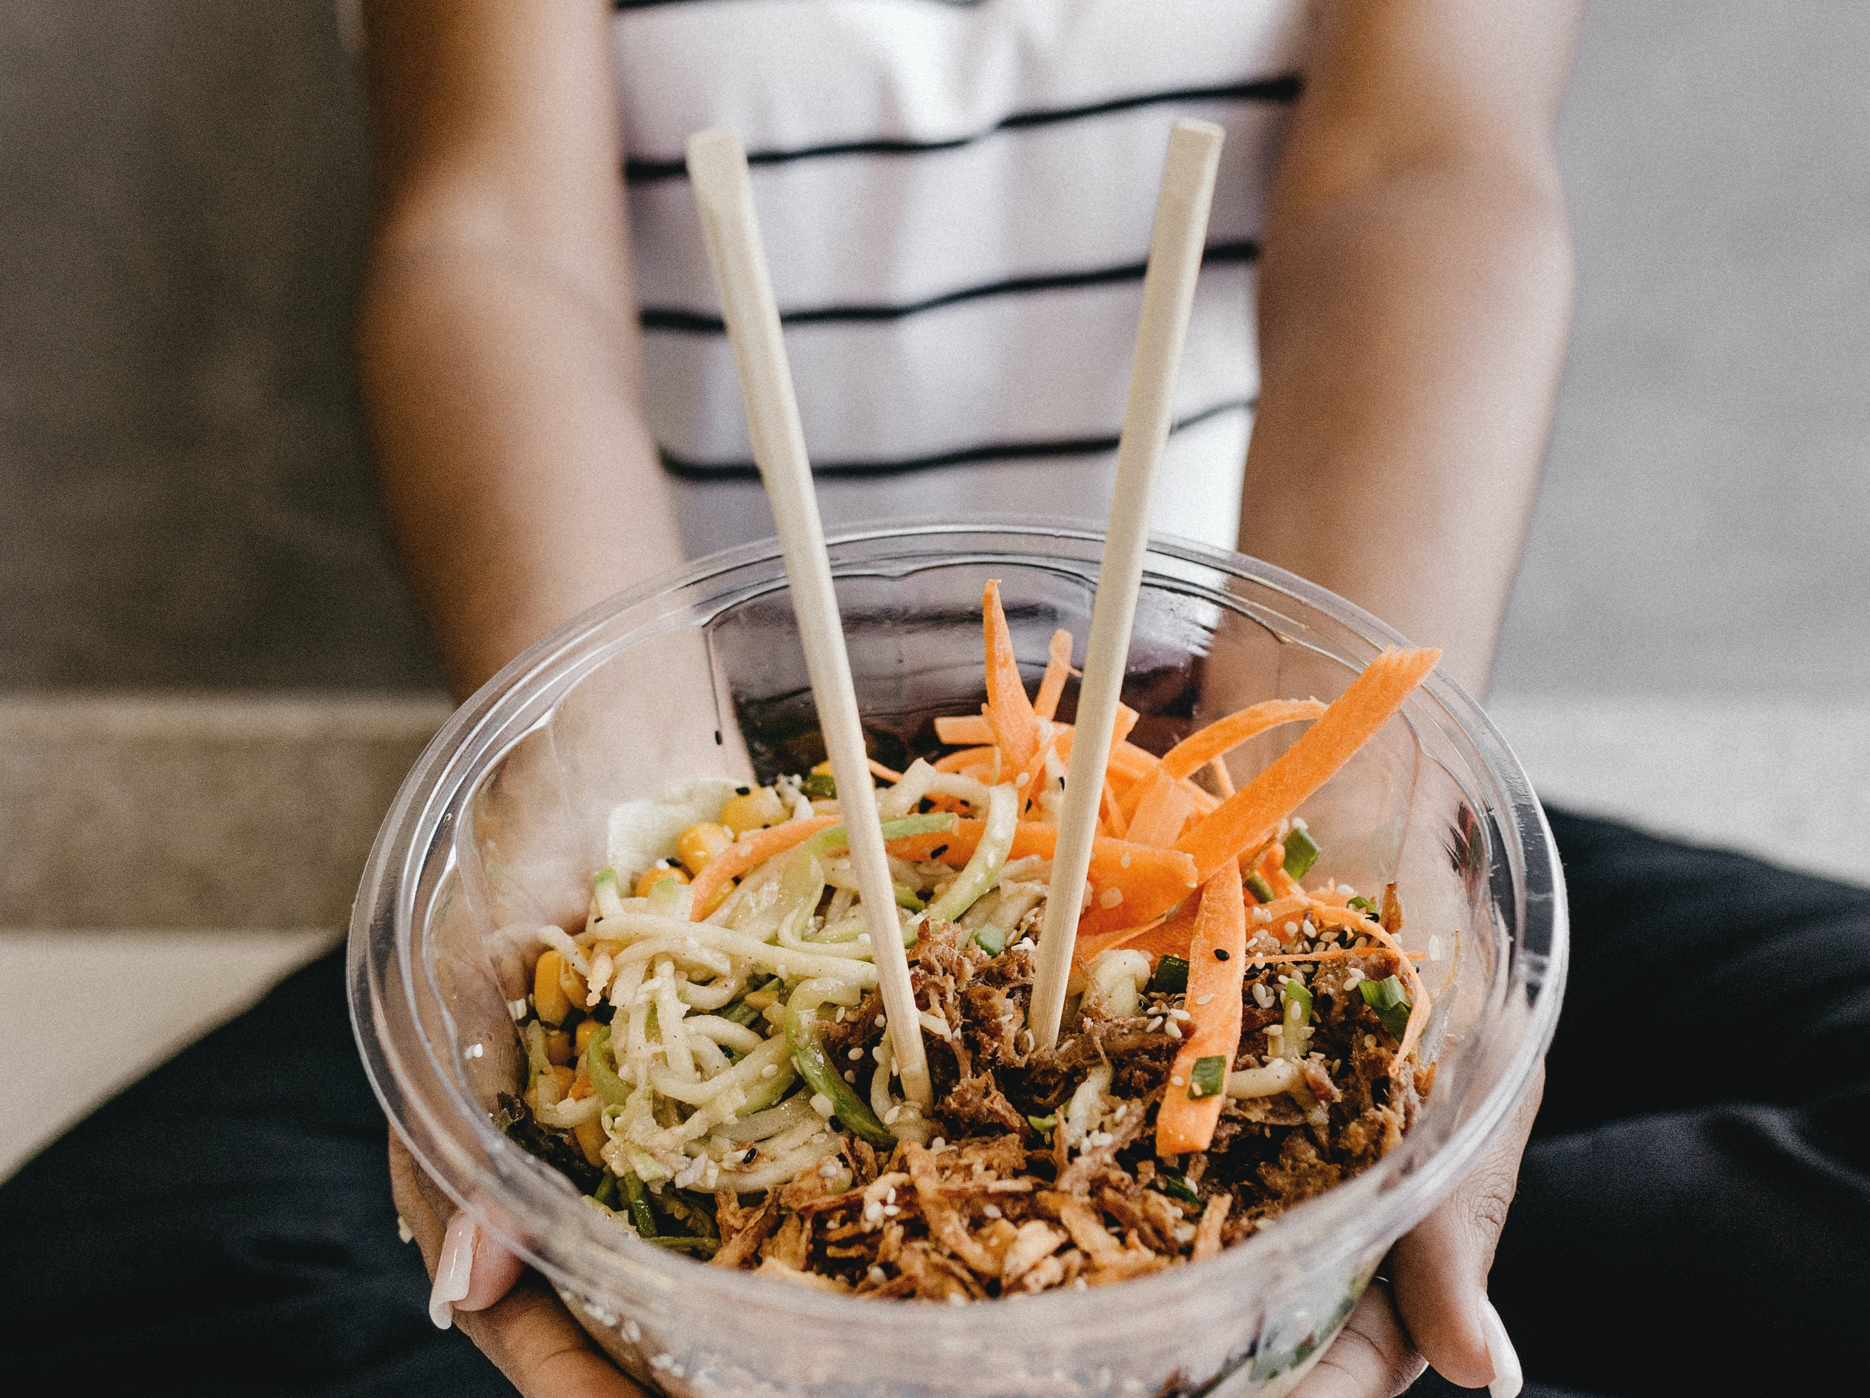
Thank you for taking the time to listen

